Slide 1
Deep Clustering Using Pseudolabels and Centroids Diploma Thesis Papadopoulos Nikolaos, Ioannina, October 2022
Supervisor
Aristidis Likas
Professor
Use of Multilayer Perceptrons’ hidden representations as input for clustering algorithms
Oversaw my thesis step-by-step
Gave me the necessary knowledge on the subject of Deep Learning
Compressing the information in autoencoders’ latent space, use latent space as input for clustering algorithms
Use of Deep Convolutional Neural Networks for image datasets
Deep clustering
Helped me tackle many problems during the study

Slide 2
Introduction
Machine learning
The process in which a computer program learns by itself how to perform a task from given data. In this process, the program adjusts to the needs of the given goal and improves its performance by experience.
Clustering
The unsupervised process of assigning labels to unlabelled elements. The purpose of clustering algorithms is to group data points together in clusters.
Deep Clustering
Takes advantage of deep networks trained during a preliminary unsupervised stage. These networks offer representations that significantly improve the results Clustering algorithms.
ML algorithms are split into two categories, unsupervised and supervised. Unsupervised algorithms learn from the features of each datapoint and try to find hidden patterns.
Agglomerative clustering: Type of hierarchical clustering algorithm. Group-wise distance function.
Deep clustering loss functions: 1) Autoencoder reconstruction loss: $L= \sum_{i}{||}{x_{i}−f_{autoencoder}(x)||}^{2}$ 2) Clustering loss
Deep clustering loss functions: 1) Autoencoder reconstruction loss: 𝐿= ∑1_𝑖▒〖||〗 〖𝑥_𝑖−𝑓_𝑎𝑢𝑡𝑜𝑒𝑛𝑐𝑜𝑑𝑒𝑟 (𝑥)||〗^2 2) Clustering loss
K-means clustering: Fixed number of clusters k, centroids initialised randomly. Euclidean distance is used as a distance function.

Slide 3
Neural Network architectures
Multilayer Perceptron:
A Multilayer Perceptron is a feedforward artificial neural network, that consists of at least one hidden layer of neurons with no linear activation function.
Autoencoder:
A networks that reconstructs its input in a layer called latent layer or bottleneck. It consists of an encoder network, a decoder network and the latent space.
Convolutional Neural Network:
A class of artificial neural network, most commonly used to analyse images. These networks mainly consist of convolution layers, pooling layers, normalization layers and fully connected layers.

Slide 4
Methods of assessing data spaces and clustering results (1)
Silhouette score/coefficient
$s\left(x_{i}\right)=\frac{b\left(x_{i}\right)−a(x_{i})}{max⁡\{b\left(x_{i}\right),a(x_{i})\}}$, where $a(x_{i})$ is the average intracluster distance and b($x_{i}$) is minimum intercluster distance.
𝑠(𝑥_𝑖 )=(𝑏(𝑥_𝑖 )−𝑎(𝑥_𝑖))/(max⁡{𝑏(𝑥_𝑖 ),𝑎(𝑥_𝑖)}), where 𝑎(𝑥_𝑖) is the average intracluster distance and b(𝑥_𝑖) is minimum intercluster distance.
Accuracy score
Normalised mutual info score (NMI)
$$MI\left(U,V\right)=\sum_{i=1}^{|U|}{\sum_{j=1}^{|V|}{\frac{|U_{i}∩V_{j}|}{N}log⁡(\frac{N|U_{i}∩V_{j}|}{\left|U_{i}\right||V_{j}|})}}$$
𝑀𝐼(𝑈,𝑉)=∑_(𝑖=1)^(|𝑈|)▒∑_(𝑗=1)^(|𝑉|)▒〖(|𝑈_𝑖∩𝑉_𝑗 |)/𝑁 log⁡((𝑁|𝑈_𝑖∩𝑉_𝑗 |)/(|𝑈_𝑖 ||𝑉_𝑗 |))〗
$$accuracy=\frac{tp+tn}{tp+fp+fn+tn}$$
𝑎𝑐𝑐𝑢𝑟𝑎𝑐𝑦=(𝑡𝑝+𝑡𝑛)/(𝑡𝑝+𝑓𝑝+𝑓𝑛+𝑡𝑛)
NMI is a normalised version, takes values between 0 and 1.

Slide 5
Methods of assessing data spaces and clustering results (2)
Adjusted Rand Index
T-distributed stochastic neighbour embedding (t-SNE)
Visualises high-dimensional data in 2D/3D spaces.
$RI=\frac{a+d}{a+b+c+d},$, calculates the agreement between two different cluster partitions U and V.
𝑅𝐼=(𝑎+𝑑)/(𝑎+𝑏+𝑐+𝑑), , calculates the agreement between two different cluster partitions U and V.
Doesn’t take constant value for two random partitions, Adjusted RI was introduced.
Converts Euclidean distances between datapoints into conditional probabilities, in both the initial and the final space.
Then, it minimises the Kullback-Leibler divergence between the two probability distributions.

Slide 6
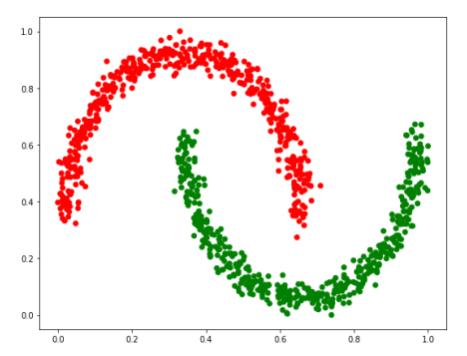
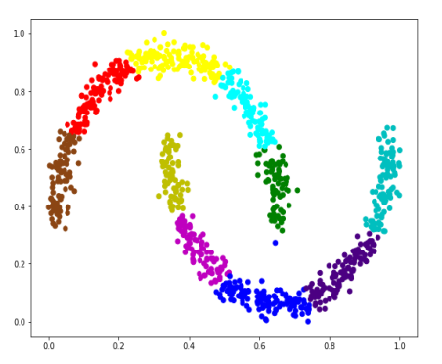
The proposed methods
There are dataspaces that make it difficult for the traditional clustering algorithms to produce good partitions.
We noticed that the k-means algorithm, in difficult-to-cluster dataspaces, has good performance if we execute the algorithm with parameter K being more than the real number of clusters of the dataset.
We take advantage of this overclustering ability of k-means with two different approaches.
K-means execution for K=10

Slide 7
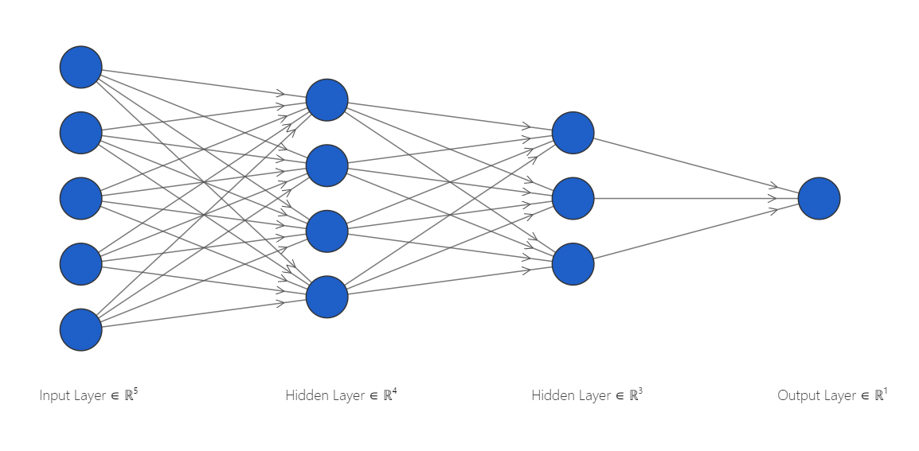
Deep Clustering method number 1: Multilayer Perceptron’s hidden representations after training with pseudolabels
Run k-means for more than the real number of clusters to acquire pseudolabels
Train a Multilayer Perceptron with D =$\{(x_{i}, y_{i})\}$, where $x_{i}$ is datapoint i and $y_{i}$ is the pseudolabel of i
Train a Multilayer Perceptron with D ={(𝑥_𝑖, 𝑦_𝑖)}, where 𝑥_𝑖 is datapoint i and 𝑦_𝑖 is the pseudolabel of i
Pass the datapoints through the MLP and then extract the hidden representations of a hidden layer of the MLP (normally from the second hidden layer)
Run k-means and agglomerative clustering for the real number of clusters on the extracted hidden representations

Slide 8
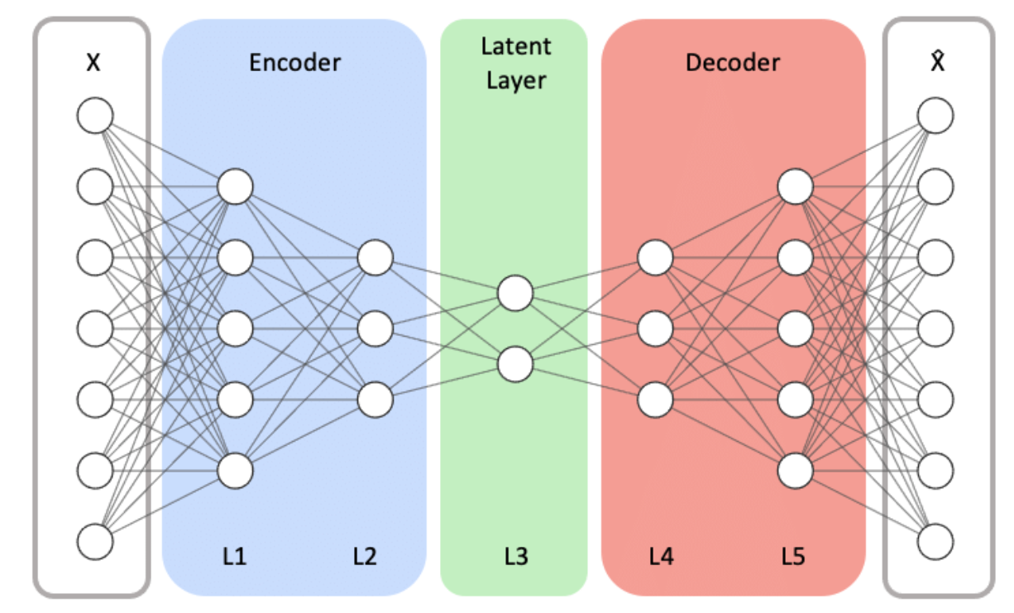
Deep Clustering method number 2: Training autoencoder network using cluster centroids
Run k-means for more than the real number of clusters to acquire its cluster centroids
Train an Autoencoder network using $E={|\left|c_{i}−{x′}_{i}\right||}^{2}$ as the reconstruction loss where $c_{i}$ is the centroid of cluster i to which datapoint $x_{i}$ has been mapped and ${x′}_{i}$ is the network’s estimation of $x_{i}$
Train an Autoencoder network using 𝐸=〖||𝑐_𝑖−〖𝑥′〗_𝑖 ||〗^2 as the reconstruction loss where 𝑐_𝑖 is the centroid of cluster i to which datapoint 𝑥_𝑖 has been mapped and 〖𝑥′〗_𝑖 is the network’s estimation of 𝑥_𝑖
Pass the datapoints through the encoder part of the network and extract the latent representation
Run k-means and agglomerative clustering for the real number of clusters on the latent representations

Slide 9
Experiments
Run k-means++ (n_init = 100) for more than the real number of clusters
1: Train the neural network using k-means’ partition
2: Execute k-means/agglomerative clustering algorithms on the latent space
3: Store the metrics of the clustering partitions that occur
Create boxplots for every metric

Slide 10
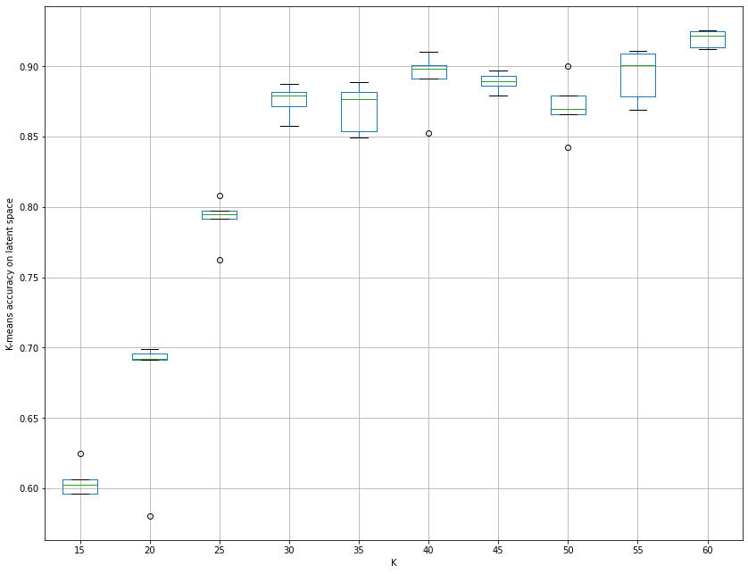
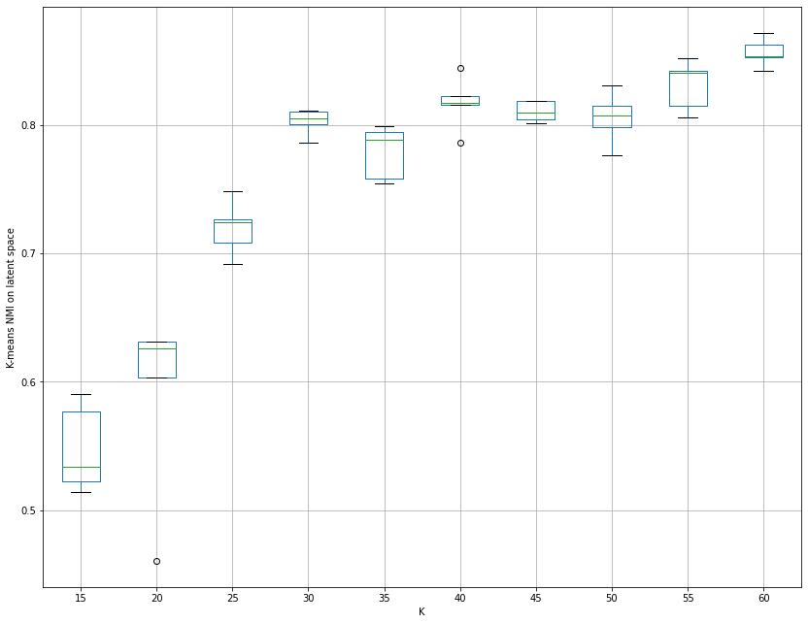
10x_73k dataset boxplots using autoencoder-trained-with-centroids method (1)

Slide 11
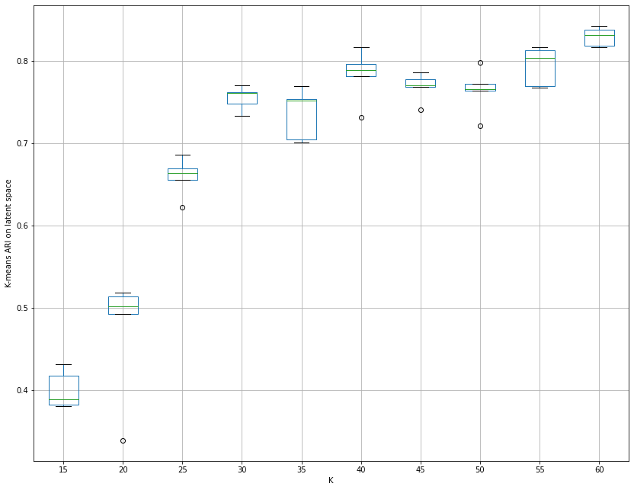
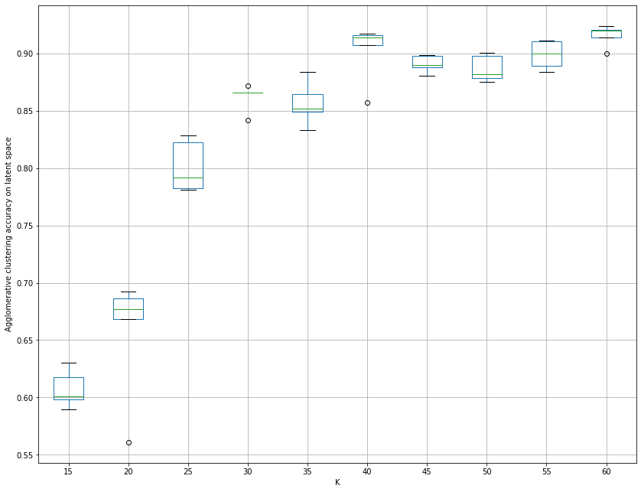
10x_73k dataset boxplots using autoencoder-trained-with-centroids method (2)

Slide 12
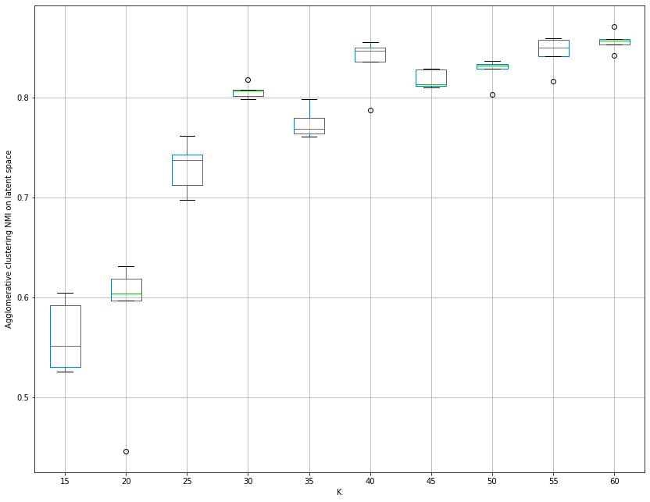
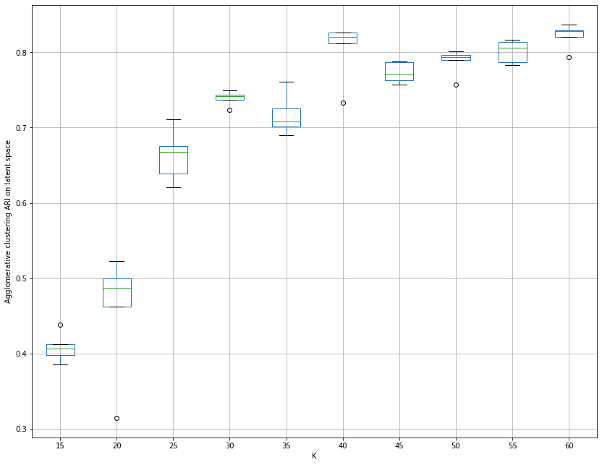
10x_73k dataset boxplots using autoencoder-trained-with-centroids method (3)

Slide 13
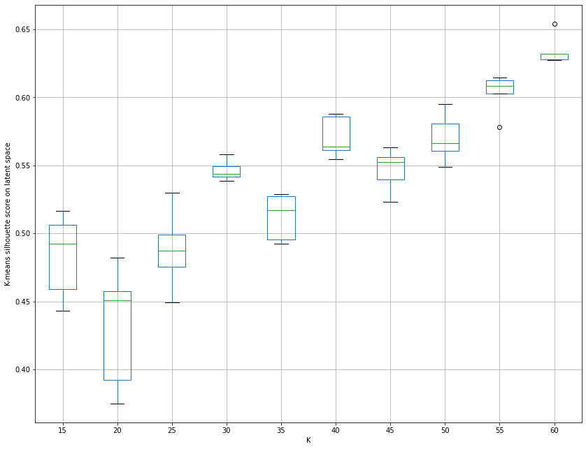
10x_73k dataset boxplots using autoencoder-trained-with-centroids method (4)

Slide 14
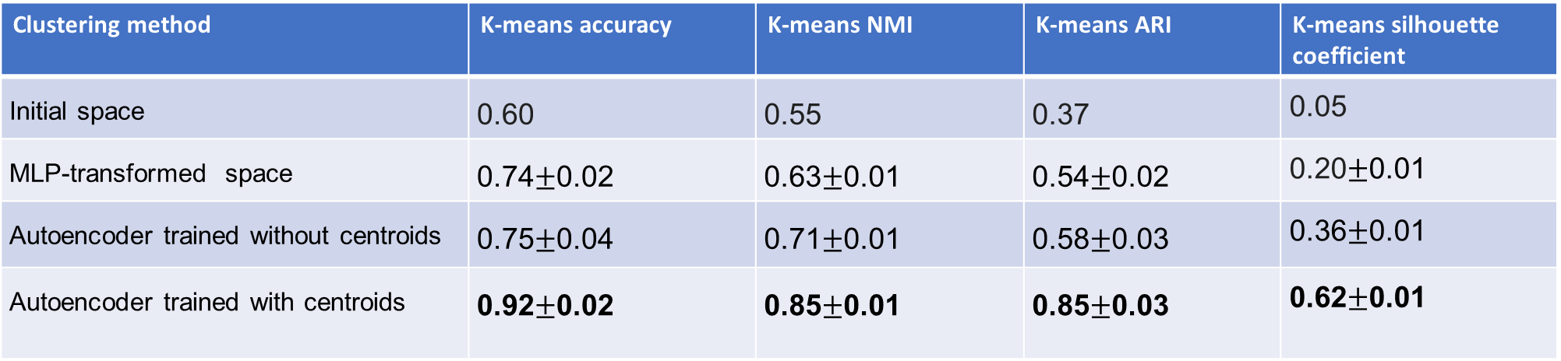
Proof of concept: training the autoencoder using the cluster centroids enhances clustering performance in the latent space
10x_73k dataset k-means clustering metrics:
Clustering method | K-means accuracy | K-means NMI | K-means ARI | K-means silhouette coefficient
Initial space | 0.60 | 0.55 | 0.37 | 0.05
MLP-transformed space | 0.74$±$0.02 | 0.63$±$0.01 | 0.54$±$0.02 | 0.20$±$0.01
Autoencoder trained without centroids | 0.75$±$0.04 | 0.71$±$0.01 | 0.58$±$0.03 | 0.36$±$0.01
Autoencoder trained with centroids | 0.92$±$0.02 | 0.85$±$0.01 | 0.85$±$0.03 | 0.62$±$0.01
Hl1_neurons= 800
hl2_neurons = 300
Datapoints
10000 datapoints
Initial space scaling: divide datapoints by max
Parameters
Activation = Sigmoid
Optimiser = Adam (lr = 10⁻⁴, weight_decay =10⁻⁵ )
latent_dimension =8
Encoder – bottleneck part (decoder = encoder’s mirror)
Loss function = MSE
No latent space scaling
#1 in best of our knowledge!

Slide 15
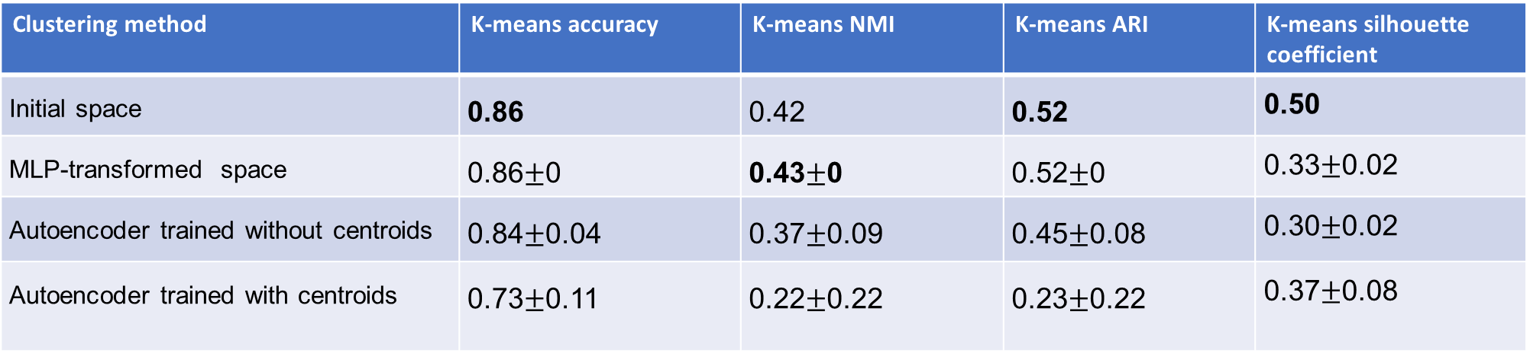
Clustering performance in the Australian dataset
Australian dataset k-means clustering metrics:
Clustering method | K-means accuracy | K-means NMI | K-means ARI | K-means silhouette coefficient
Initial space | 0.86 | 0.42 | 0.52 | 0.50
MLP-transformed space | 0.86$±$0 | 0.43$±$0 | 0.52$±$0 | 0.33$±$0.02
Autoencoder trained without centroids | 0.84$±$0.04 | 0.37$±$0.09 | 0.45$±$0.08 | 0.30$±$0.02
Autoencoder trained with centroids | 0.73$±$0.11 | 0.22$±$0.22 | 0.23$±$0.22 | 0.37$±$0.08
Hl1_neurons = 500
hl2_neurons = 300
Datapoints
690 datapoints
Initial space scaling: MinMax
Parameters
Activation = Sigmoid
Optimiser = Adam (lr = 10⁻⁴, weight_decay =10⁻⁵ )
latent_dimension = 5
Encoder – bottleneck part (decoder = encoder’s mirror)
Loss function = MSE
No latent space scaling
No improvement in this case

Slide 16
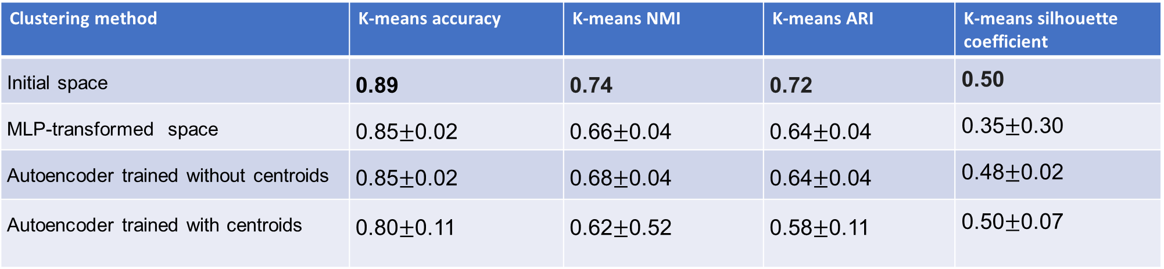
Clustering performance in the Iris dataset
Iris dataset k-means clustering metrics:
Clustering method | K-means accuracy | K-means NMI | K-means ARI | K-means silhouette coefficient
Initial space | 0.89 | 0.74 | 0.72 | 0.50
MLP-transformed space | 0.85$±$0.02 | 0.66$±$0.04 | 0.64$±$0.04 | 0.35$±$0.30
Autoencoder trained without centroids | 0.85$±$0.02 | 0.68$±$0.04 | 0.64$±$0.04 | 0.48$±$0.02
Autoencoder trained with centroids | 0.80$±$0.11 | 0.62$±$0.52 | 0.58$±$0.11 | 0.50$±$0.07
Hl1_neurons= 500
hl2_neurons = 200
Datapoints
150 datapoints
Initial space scaling: MinMax
Parameters
Activation = Sigmoid
Optimiser = Adam (lr = 10⁻⁴, weight_decay =10⁻⁵ )
latent_dimension = 3
Encoder – bottleneck part (decoder = encoder’s mirror)
Loss function = MSE
No latent space scaling
No improvement in this case

Slide 17
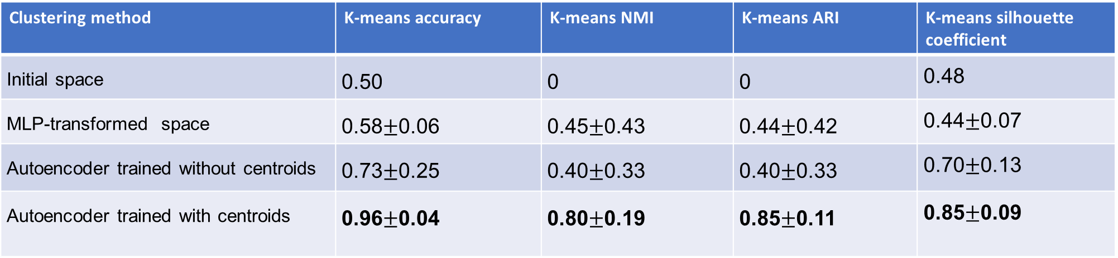
Clustering performance in the squeezed gaussian blobs dataset
Squeezed gaussian blobs dataset k-means clustering metrics:
Clustering method | K-means accuracy | K-means NMI | K-means ARI | K-means silhouette coefficient
Initial space | 0.50 | 0 | 0 | 0.48
MLP-transformed space | 0.58$±$0.06 | 0.45$±$0.43 | 0.44$±$0.42 | 0.44$±$0.07
Autoencoder trained without centroids | 0.73$±$0.25 | 0.40$±$0.33 | 0.40$±$0.33 | 0.70$±$0.13
Autoencoder trained with centroids | 0.96$±$0.04 | 0.80$±$0.19 | 0.85$±$0.11 | 0.85$±$0.09
Hl1_neurons= 800
hl2_neurons = 300
Datapoints
1000 datapoints
Initial space scaling: None
Parameters
Activation = Sigmoid
Optimiser = Adam (lr = 10⁻⁴, weight_decay =10⁻⁵ )
latent_dimension = 1
Encoder – bottleneck part (decoder = encoder’s mirror)
Loss function = MSE
No latent space scaling

Slide 18
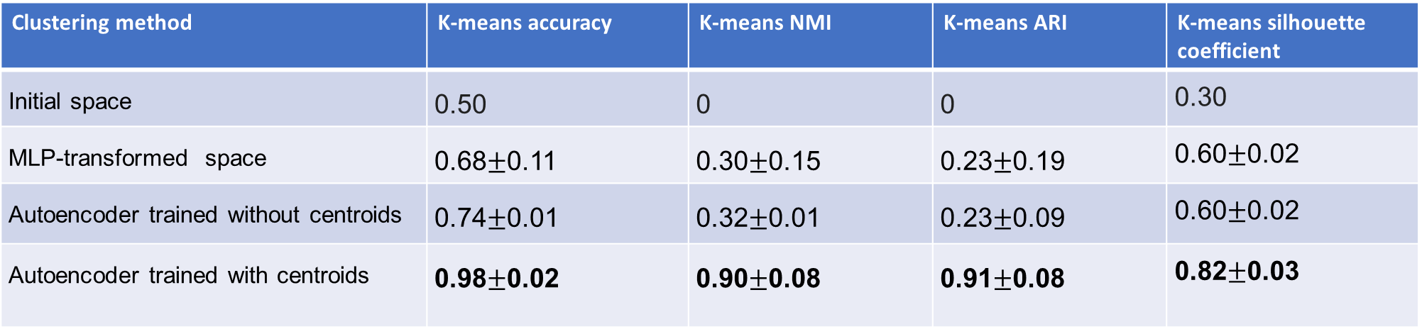
Clustering performance in the gaussian rings dataset
Gaussian rings dataset k-means clustering metrics:
Clustering method | K-means accuracy | K-means NMI | K-means ARI | K-means silhouette coefficient
Initial space | 0.50 | 0 | 0 | 0.30
MLP-transformed space | 0.68$±$0.11 | 0.30$±$0.15 | 0.23$±$0.19 | 0.60$±$0.02
Autoencoder trained without centroids | 0.74$±$0.01 | 0.32$±$0.01 | 0.23$±$0.09 | 0.60$±$0.02
Autoencoder trained with centroids | 0.98$±$0.02 | 0.90$±$0.08 | 0.91$±$0.08 | 0.82$±$0.03
Hl1_neurons= 800
hl2_neurons = 300
Datapoints
1000 datapoints
Initial space scaling: MinMax
Parameters
Activation = ReLU
Optimiser = Adam (lr = 10⁻⁴, weight_decay =10⁻⁵ )
latent_dimension = 1
Encoder – bottleneck part (decoder = encoder’s mirror)
Loss function = MSE
No latent space scaling

Slide 19
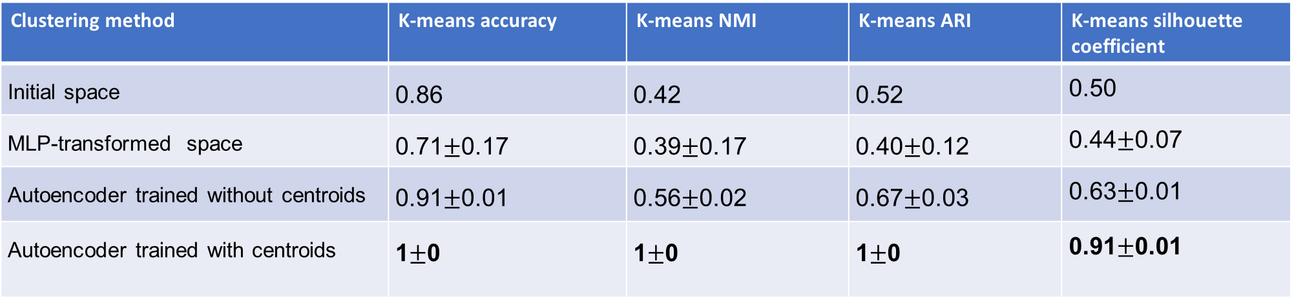
Clustering performance in the moons dataset
Moons dataset k-means clustering metrics:
Clustering method | K-means accuracy | K-means NMI | K-means ARI | K-means silhouette coefficient
Initial space | 0.86 | 0.42 | 0.52 | 0.50
MLP-transformed space | 0.71$±$0.17 | 0.39$±$0.17 | 0.40$±$0.12 | 0.44$±$0.07
Autoencoder trained without centroids | 0.91$±$0.01 | 0.56$±$0.02 | 0.67$±$0.03 | 0.63$±$0.01
Autoencoder trained with centroids | 1$±$0 | 1$±$0 | 1$±$0 | 0.91$±$0.01
Hl1_neurons= 400
hl2_neurons = 200
Datapoints
1000 datapoints
Initial space scaling: MinMax
Parameters
Activation = Sigmoid
Optimiser = Adam (lr = 10⁻⁴, weight_decay =10⁻⁵ )
latent_dimension = 1
Encoder – bottleneck part (decoder = encoder’s mirror)
Loss function = MSE
No latent space scaling

Slide 20
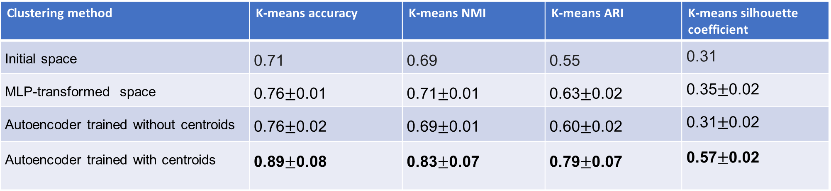
Clustering performance in the pendigits dataset
Pendigits dataset k-means clustering metrics:
Clustering method | K-means accuracy | K-means NMI | K-means ARI | K-means silhouette coefficient
Initial space | 0.71 | 0.69 | 0.55 | 0.31
MLP-transformed space | 0.76$±$0.01 | 0.71$±$0.01 | 0.63$±$0.02 | 0.35$±$0.02
Autoencoder trained without centroids | 0.76$±$0.02 | 0.69$±$0.01 | 0.60$±$0.02 | 0.31$±$0.02
Autoencoder trained with centroids | 0.89$±$0.08 | 0.83$±$0.07 | 0.79$±$0.07 | 0.57$±$0.02
Hl1_neurons= 800
hl2_neurons = 300
Datapoints
7494 datapoints
Initial space scaling: MinMax
Parameters
Activation = Sigmoid
Optimiser = Adam (lr = 10⁻⁴, weight_decay =10⁻⁵ )
latent_dimension =8
Encoder – bottleneck part (decoder = encoder’s mirror)
Loss function = MSE
No latent space scaling
#1 in best of our knowledge!

Slide 21
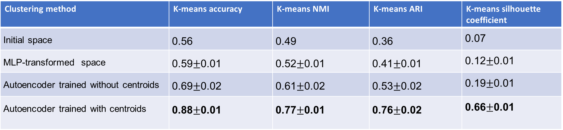
Clustering performance in the MNIST dataset
MNIST dataset k-means clustering metrics:
Clustering method | K-means accuracy | K-means NMI | K-means ARI | K-means silhouette coefficient
Initial space | 0.56 | 0.49 | 0.36 | 0.07
MLP-transformed space | 0.59$±$0.01 | 0.52$±$0.01 | 0.41$±$0.01 | 0.12$±$0.01
Autoencoder trained without centroids | 0.69$±$0.02 | 0.61$±$0.02 | 0.53$±$0.02 | 0.19$±$0.01
Autoencoder trained with centroids | 0.88$±$0.01 | 0.77$±$0.01 | 0.76$±$0.02 | 0.66$±$0.01
hl1_neurons= 32
hl2_neurons = 64
Datapoints
10000 datapoints
Initial space scaling: divide datapoints by max
Parameters
Activation = Sigmoid
Optimiser = Adam (lr = 10⁻⁴, weight_decay =10⁻⁵ )
latent_dimension = 10
Encoder – bottleneck part (decoder = encoder’s mirror)
Loss function = MSE
No latent space scaling
hl3_neurons = 128
Convolution layers parameters
Layer 1: kernel_size = 5, stride = 2, padding = 2
Layer 2: kernel_size = 5, stride = 2, padding = 2
Layer 3: kernel_size = 3, stride = 2, padding = 0

Slide 22
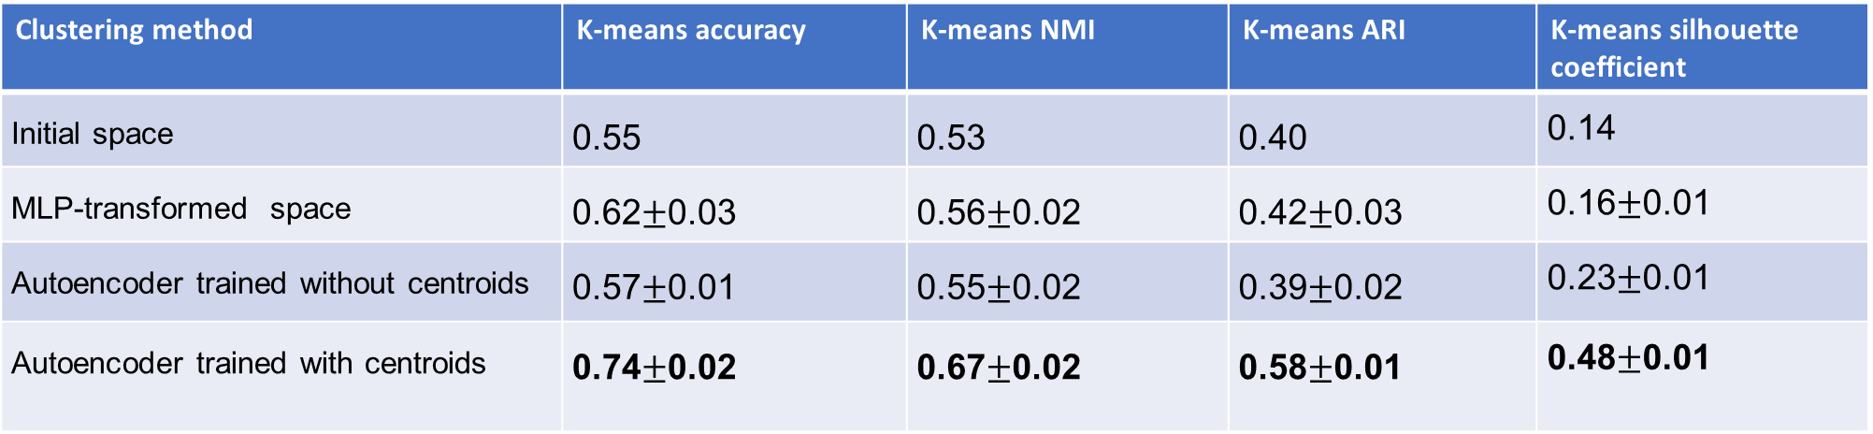
Clustering performance in the Fashion-MNIST dataset
Fashion-MNIST dataset k-means clustering metrics:
Clustering method | K-means accuracy | K-means NMI | K-means ARI | K-means silhouette coefficient
Initial space | 0.55 | 0.53 | 0.40 | 0.14
MLP-transformed space | 0.62$±$0.03 | 0.56$±$0.02 | 0.42$±$0.03 | 0.16$±$0.01
Autoencoder trained without centroids | 0.57$±$0.01 | 0.55$±$0.02 | 0.39$±$0.02 | 0.23$±$0.01
Autoencoder trained with centroids | 0.74$±$0.02 | 0.67$±$0.02 | 0.58$±$0.01 | 0.48$±$0.01
hl1_neurons= 32
hl2_neurons = 64
Datapoints
10000 datapoints
Initial space scaling: divide datapoints by max
Parameters
Activation = ReLU
Optimiser = Adam (lr = 10⁻⁴, weight_decay =10⁻⁵ )
latent_dimension = 10
Encoder – bottleneck part (decoder = encoder’s mirror)
Loss function = MSE
No latent space scaling
hl3_neurons = 128
Convolution layers parameters
Layer 1: kernel_size = 5, stride = 2, padding = 2
Layer 2: kernel_size = 5, stride = 2, padding = 2
Layer 3: kernel_size = 3, stride = 2, padding = 0

Slide 23
T-SNE representation changes from initial space to latent space: 10x_73k dataset
10x_73k initial space
10x_73k latent space

Slide 24
T-SNE representation changes from initial space to latent space: MNIST dataset
MNIST initial space
MNIST latent space

Slide 25
T-SNE representation changes from initial space to latent space: Pendigits dataset
Pendigits initial space
Pendigits latent space

Slide 26
T-SNE representation changes from initial space to latent space: Iris dataset
Iris initial space
Iris latent space

Slide 27
T-SNE representation changes from initial space to latent space: Gaussian rings dataset
Gaussian rings initial space
Gaussian rings latent space

Slide 28
T-SNE representation changes from initial space to latent space: Moons dataset
Moons initial space
Moons latent space

Slide 29
T-SNE representation changes from initial space to latent space: Fashion MNIST dataset
Fashion MNIST initial space
Fashion MNIST latent space

Slide 30
Overclustering criterion based on silhouette score (1)
Extract one representation $r_{i}$, i = 1, …, n, from each choice of number of clusters we want to try, $kε\left\{k_{1}, …,k_{n}\right\}.$
Extract one representation 𝑟_𝑖, i = 1, …, n, from each choice of number of clusters we want to try, 𝑘𝜖{𝑘_1, …,𝑘_𝑛 }.
Execute k-means one time on every representation for each of the choices of number of clusters, calculate the silhouette coefficient for every partition and then store the maximum silhouette score of the representation:
$$\hat{S}\left(r\right)={argmax}_{k}sil(r,k)$$
Execute k-means one time on every representation for each of the choices of number of clusters, calculate the silhouette coefficient for every partition and then store the maximum silhouette score of the representation:
𝑆 ̂(𝑟)=〖𝑎𝑟𝑔𝑚𝑎𝑥〗_𝑘 𝑠𝑖𝑙(𝑟,𝑘)
Calculate the silhouette score of the clustering partition that a k-means run for each representation provides with the real number of clusters M. Normalise this result by dividing it with the value $\hat{S}\left(ri\right)$ that corresponds to representation $ri$:
$\hat{S}\left(r,M\right)=\frac{sil(r,M)}{\hat{S}(r)}$
Calculate the silhouette score of the clustering partition that a k-means run for each representation provides with the real number of clusters M. Normalise this result by dividing it with the value 𝑆 ̂(r_{i)} that corresponds to representation r_{i}:
𝑆 ̂(𝑟,𝑀)=(𝑠𝑖𝑙(𝑟,𝑀))/(𝑆 ̂(𝑟))
Choose the representation r* that has the highest normalised value as the best representation
$$r^{∗}={argmax}_{k}\hat{S}\left(r,M\right)$$
Choose the representation r* that has the highest normalised value as the best representation
𝑟^∗=〖𝑎𝑟𝑔𝑚𝑎𝑥〗_𝑘 𝑆 ̂(𝑟,𝑀)
Run k-means for each k, train an autoencoder with the partition’s centroids and extract the latent space representations.

Slide 31
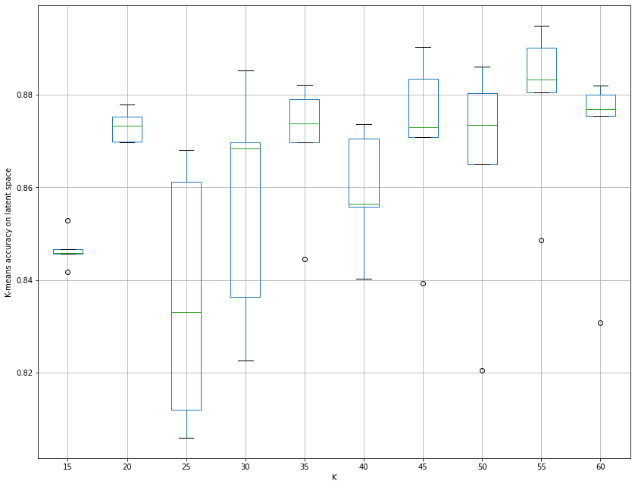
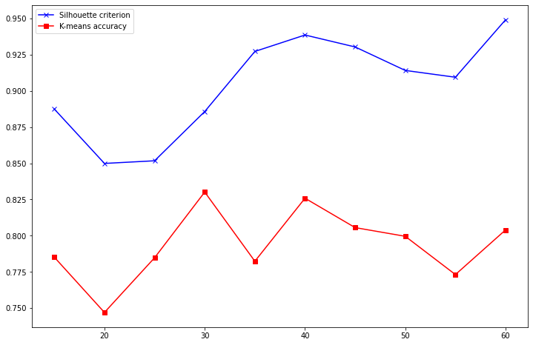
Overclustering criterion based on silhouette score (2)

Slide 32
Thank you for your time

